Slide 1

“Enhancing Search Engine Relevance for Video Subtitles”
Submitted By:
Team ID: T211013
1. Rashmitha Padmanabhuni - IN1240769
2. Vinay Kumar Dussa – IN1240948

Slide 2
OBJECTIVE
The aim of this project is to devise a refined search engine algorithm that can effectively fetch subtitles in response to user queries. The algorithm will prioritize the content of the subtitles and to accomplish this, we will utilize natural language processing (NLP) and machine learning (ML) techniques. These techniques will ultimately enhance the precision and pertinence of the search results provided to the user.
Create a sophisticated search algorithm that efficiently retrieves subtitles according to user queries, with a special focus on the content of the subtitles.
Utilize natural language processing (NLP) and machine learning (ML) techniques to enhance the accuracy and relevance of the search results.

Slide 3
INTRODUCTION
In the modern era of abundant information, search engines serve as pathways that link users to an ever-growing ocean of digital material. Google, a pioneer in search advancements, is committed to offering effortless and enlightening search encounters. This endeavor addresses the obstacle of enhancing the significance of video content by employing subtitles. Our goal is to unlock the information within videos and enable a wider audience to effortlessly access it.

Slide 4
TYPES OF SEARCH ENGINES
A keyword-based search engine works by finding exact words in your query and matching them to indexed documents. While it is simpler, it has difficulty with synonyms or variations in phrasing. This type of search engine will only match our search query to web pages that contain the same keywords, without taking into account the deeper meaning or context of those words.
On the other hand, a semantic-based search engine goes beyond just matching keywords. It understands the meaning and context of your search, allowing it to deliver relevant results even if the query is phrased differently. This type of search engine is much more efficient and provides superior results when compared to keyword-based search engines.

Slide 5
WORKFLOW
There are two important steps that must be followed to implement search engine. They are as follows:
Ingesting the Documents
1. Data Sampling
2. Data Preprocessing
3. Document Chunking
4. Text Vectorization
5. Storing Embeddings in Chromadb
Retrieving the Documents
1. Take the user's search query and preprocess the query (if needed).
2. Create query embedding.
3. Using cosine distance, calculate the similarity score b/w embeddings of documents and user query.
4. Returns the most relevant candidate documents as per user’s search query.

Slide 6
INGESTING THE DOCUMENTS
1. Data Sampling
We began with a file called "eng_subtitle_database.db." Initially, we utilized sqlite3 to establish a connection with the database and retrieve the dataset. Subsequently, we needed to load the dataset as a pandas dataframe in order to proceed with additional processing. However, we encountered an initial challenge when it came to sampling the data, as there were approximately 82k subtitles available. To address this, we decided to only use 50% of the total content.

Slide 7
INGESTING THE DOCUMENTS
2. Data Preprocessing
We developed a unique function that carries out multiple operations on the text data. These operations involve:
- Removing timestamps that indicate the data collection time.
- Converting all the text to lowercase to ensure consistency.
- Excluding common words (stopwords) that lack significant meaning.
- Removing any non-text elements, such as symbols or punctuation marks.
Moreover, we are currently facing difficulties with the dataset due to system configuration limitations. As a result, we have saved the cleaned dataset as a parquet file to enhance memory optimization and expedite data loading and retrieval. Parquet files offer improved memory efficiency and faster performance compared to csv files.

Slide 8
INGESTING THE DOCUMENTS
3. Document Chunking
When it comes to handling extensive text data, a method known as "embeddings" can be utilized to convey the text in a manner that machines can comprehend. Nevertheless, this technique may occasionally result in the omission of crucial details, particularly when dealing with lengthy documents.
To address the loss of information when embedding substantial text portions, a technique called "chunking" is employed.
By dividing documents into smaller and more manageable sections, we can generate more precise text embeddings that machines can comprehend more effectively.
This approach resembles breaking down sizable documents into easily digestible portions to enhance understanding.

Slide 9
INGESTING THE DOCUMENTS
4. Text Vectorization
In order to enhance communication between humans and machines, we utilize a technique known as "text vectorization." This process involves translating words into numerical representations that machines can comprehend and analyze. Various methods exist for this conversion, each offering different levels of sophistication:
1. BOW/TF-IDF: This method creates a basic identification by tallying word occurrences. It is particularly adept at identifying exact matches, making it ideal for keyword-based search engines that prioritize locating specific terms.
2. BERT Embeddings: (implemented in this project): This more advanced approach delves deeper, taking into account not only word frequency but also meaning and context. BERT excels in semantic search, which involves understanding the overall intent of a query. By employing BERT embeddings, we empower the search engine to grasp the subtleties of human language, resulting in more relevant and insightful retrieval of video content.

Slide 10
INGESTING THE DOCUMENTS
5. Storing Embeddings in ChromaDB
ChromaDB is a unique type of database that is specifically designed to handle vector representations. It goes beyond being just a storage facility for our embeddings. With ChromaDB, we have the ability to enhance our embeddings by adding additional information such as timestamps or categories, which makes the data more informative. This database also allows us to search for specific embeddings based on their metadata, similar to how one would filter books in a library. Additionally, we have the option to choose between storing the data in memory for quick access (although temporary) or on a hard drive for long-term storage (with slower access). This flexibility ensures that we can optimize our storage based on our specific needs. In summary, ChromaDB enables us to efficiently filter and search through a vast collection of embeddings by utilizing their associated metadata.

Slide 11
RETRIEVING THE RESULTS
Retrieving the Documents
1. Start by preparing the user's search query, making any necessary adjustments.
2. Generate an embedding for the query.
3. Measure the similarity between the embeddings of the documents and the user's query using cosine distance.
4. Provide the user with the most suitable candidate documents based on their search query.

Slide 12

RESULTS (SCREENSHOTS)

Slide 13
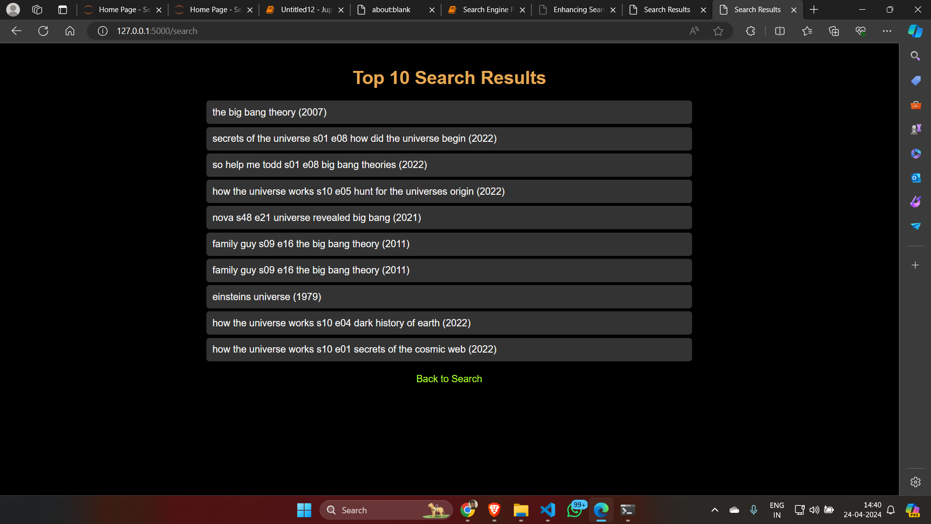
RESULTS (SCREENSHOTS)

Slide 14
CONCLUSION
This method has the ability to transform video search by utilizing natural language processing and semantic search. By directing our attention to the extensive information found in subtitles, we can achieve more precise and pertinent search outcomes. This not only improves the user experience for all individuals, but also enables a larger audience to tap into the vast knowledge contained in video content. This project marks a substantial advancement, leading us towards a future of video search that is even more inclusive and informative.
SEARCH ENGINE CODE
Github
Check out the code at Github. Follow the url : https://github.com/Rashmitha284/Semantic-Search-Engine

Slide 15

THANK YOU

